Slide 1
Project Initiation
MONTH, 2022
NAME,
Customer Solutions

Slide 2
Agenda
Goal of the project initiation phase
The Pricefx Project Implementation Methodology
Your roles and our roles
What needs to be prepared
SoW Review & update project timeline
Prepare kickoff meeting

Slide 3
Goal of the Project Initiation Sprint

Slide 4
Goal of the Project Initiation Phase
Get a common understanding on the scope of the project
Agree on the way of working together, including roles and responsibilities
Finalize the timeline of the project
Prepare the Kickoff meeting together
Work on getting the data delivery plan and first data sets delivered

Slide 5
The Pricefx Project Implementation Methodology

Slide 6
Implementation Methodology – Hybrid Agile
Waterfall at the start – Delivery is Agile – Closure is waterfall again
Requirements Workshop
In the SoW:
Proposed Timeline
Requirements overview
User Stories
Estimations
Handover
Internal Pricefx handover call from sales to project team
Project
Initiation
Foundation
Sprint
Preparation
& Setup Sprint
Feature
Sprints
Duration: 2-4 weeks
Integrated Systems Testing
E2E testing of business scenarios
End user training
Go-live acceptance
UAT
Sprint
Duration: 2-6 weeks
Topics to be covered:
Customer Team setup
Data Readiness / Interfaces
Pricing processes documentation
Agile Overview
Meeting cadences
Setting up DEV & QA partitions
Duration: 3 weeks
Onsite meeting where possible
User story detailing
Business requirements detailing
Gate review on estimations SoW vs foundation week
Kickoff Training for the customer
Duration: 1 week
Sprint 1 planning
First data drop delivery
Prepare tables
Loading sample data
(Manual – small real data set)
Duration: each sprint 3 weeks; 2 – 6 sprints
Incremental development of user stories
Sprint testing by customers
Acceptance of the incremental delivery
Cutover
Preparation
Sprint
Stabilization
Sprint
Project Closure
Duration: 1-2 weeks
Cutover planning
All system coordination
Technical Go-Live
Duration: 2 weeks
Support via JIRA
Main contact: CSM
Project Closure

Slide 7












Initial Sales Call
Value Scenario
Value Proposal
Requirements workshop
Foundation workshop
Feature Sprints
Notes:
In the beginning we know some of the requirements; every phase we get to know more, but still it is very difficult to understand the full depth of things.
This is also because we talk to different people. Typically in the sales cycle more people get added, which adds to the requirements. Then typically during the project phase, a whole new team gets assigned – which might bring very different things to the table.
At some point we might see fish, and signs of sharks. Important is to stick to the agreed MVP – that is where Agile comes in, making sure we focus on the essential things.

Slide 8

Initial Sales Call
Value Scenario
Value Proposal
Requirements workshop & SoW Creation
SoW is documenting requirements as given during the requirements workshop
These documented requirements have been estimated
The more time spent together, the more detailed requirements are given
It is impossible to fully understand the depth during the sales cycle – we need to focus on MVP
Foundation creation
Feature Sprints

Slide 9
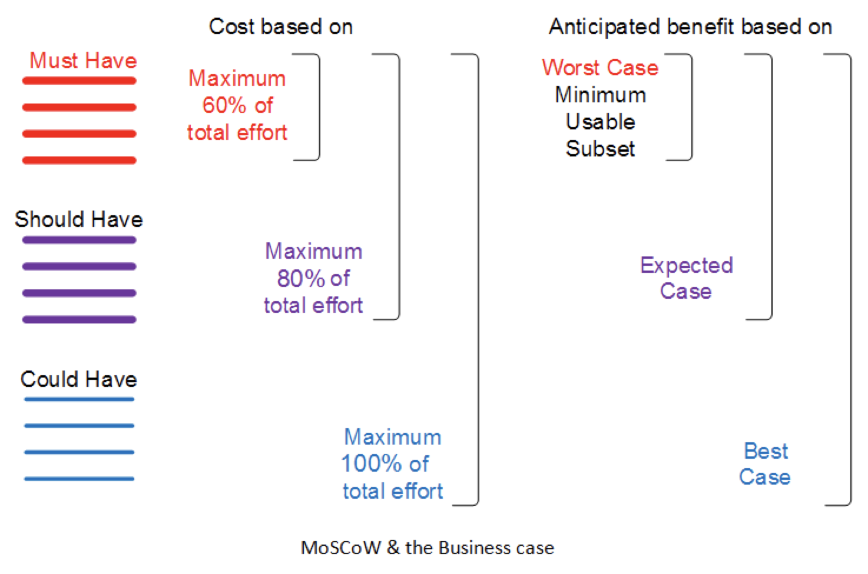
Key elements - Prioritization
As requirements tend to grow, prioritization is key – not everything will be delivered in the first phase

Slide 10
Standard Scrum Process
Pre-Game Staging Sprint
Development Sprints
Wrapper Sprints
24
Std.
PRODUCT BACKLOG
VISION
SPRINT 3 WEEKS
PRODUCT
SPRINT BACKLOG
INCREMENT
SPRINT REVIEW
SPRINT PLANNING
x 3-4

Slide 11
Your roles and our roles

Slide 12
Customer’s project activities
During the project
Manage overall project and individual regional sub-projects.
Provide all required and agreed Customer resources for the project.
Define and document user stories and acceptance criteria based on of Pricefx project requirements.
Prepare, deliver and validate the data that is necessary for the solution before the start of development.
Manage all needed changes to non-Pricefx systems
Prepare all system and end-user documentation and plan and execute the change management program, incl. end user training.
Take a leading role in unit testing during the feature sprints and approving/accepting all user stories.
Prepare end-to-end UAT test scripts and execute these during UAT.

Slide 13
Customer's Proposed / Expected Project Roles
Scrum Project Role | Functional Purpose | Role Description | Time Commitment
Product Owner | Business owner who will own the ultimate success for the solution | Sets priorities, creates/manage user stories and manages backlog. Provides the functional leadership during the implementation. | 25-50% of entire project
IT Project Manager | Project Manager | Manages the overall project for the customer and the customer’s team and stakeholders. S/he is experienced in ERP level IT projects and as part of their responsibilities, is responsible for resource management and scheduling, internal communications, escalations, removing organizational impediments by working in tandem with the Pricefx Project Manager | 25-50% of entire project
Change Manager | Change Manager | Leading the process and organizational changes within the organization and removing all change related impediments | 25-50% of entire project
Pricing Team Lead(s) / SME(s) | Subject Matter Expert (SME) | Pricing experts who understand the as-is process, helps define future-state process flows and is deeply involved in the requirements stage. | 25-50% of entire project
Testing Lead | Functional & data Tester | Provides acceptance criteria for each user story so that business requirements are met. Tests each user story and corresponding data to ensure the application works as expected. Leads UAT | 25-50% of entire project
IT/Data Lead | Data/Integration Expert | Go-to IT lead who is expert on the IT landscape. S/he will be responsible for integrating the system and assists with defining and developing the extracts from data warehouse and other source systems. | 30-35% of entire project
Executive Sponsor | Project Sponsor | Key organizational champion and spokesperson for the project, participates in Steering Committee meetings and assists with escalations. | 5% of entire project
13

Slide 14





Customer's Resources Allocation
Recommendation based on previous experience
Project Initiation
Foundation
Planning
Data Setup
Sprint 1
Sprint 2
Sprint 3
…
UAT
Cut-over
Stabilization
Project Phase Project role | Foundation, Planning & Setup | Feature Sprints | UAT | Cutover & Stabilization
IT Project Manager | 50 % | 50 % | 50 % | 50 %
Product Owner | 25 % | 25 % | 25 % | 25 %
Change Manager | 25 % | 15 % | 50 % | 50 %
Pricing Team Lead / SME ¹ - User stories / Test scripts | 100 % | 25 % | 100 %
Pricing Team Lead / SME ² - Testing |  | 25- 100% | 100 %
Pricing Team Lead / SME ³ - Training material and exec |  | 0-50 % | 50 % | 100 %
Data leads ⁴ | 100 % | 20 % | 20 % | 20 %
IT Leads (Interfacing) ⁵ | 20 % | 100 % | 100 % | 100 %
Writing user stories and user test scripts
Unit testing of the user stories and executing the UAT
Creating all internal training materials and executing the training
Providing data in a manual fashion. Making sure the quality of the data increases over time
Implement all needed changes to other systems. Building interfaces
To be replaced by actual role name from the industry playbook, e.g. Rebate Analyst, Cost Analyst, Pricing Manager
14

Slide 15
Pricefx Project Roles
Functional Purpose | Role Description | Time Commitment
Business Analyst | Analyzes and documents the as-is and to-be pricing processes. Advises on business practices of similar companies from earlier (Pricefx) pricing implementations​. Proposes viable pricing application solution options and approaches. Documents pricing requirements into epics and user stories, and acts as the intermediary between business key users, product owners and the application implementation team​ | 1 Part Time
Solution Architect | The solution architect will act as the primary interface to the client’s technical team as well as providing oversight and design leadership. Drives the activities and manages dependencies across teams. Expert in Pricefx capabilities, integration layer and components | 1 Part Time
Project / Program Manager | Handles contract management, resource tracking, customer communication, escalations, removing organizational impediments by working in tandem with the customer team and Pricefx team | 1 Part Time
Configuration Engineer(s) Integration Engineer | Provides skills required for successful solution delivery through user story expansion, configuration, integration, deployment, test case development and support | 1 Full Time 1 Part Time
QA Engineer | Helps ensure the Solution meets the functional and quality expectations. Identifies and addresses defects ahead of key user testing e.g., User Acceptance Testing. Provides guidance across key testing activities performed by Customer team members e.g., User Acceptance Testing to help Customers run successful tests | 1 Part Time
Pricing Scientist | Creation of segmentation model and selection of segmentation attributes. Setup POAI pricing optimization model with business objectives and constraints. Validation of optimization engine execution and results | 1 Part Time
Trainer | Provide Project Kick off Training and overview of Pricefx application. Lead a solution specific train-the-trainers session during the User Acceptance Testing sprint. And upon customer request, provide the End User Training post the solution Go Live! | 1 Part Time
15

Slide 16
Project Success Factors
Pricefx Customer Solutions
Project Success
Executive Buy-in
Data Prep.
Project Core Team
Testing & Training
Change Mgmt.
Pricing Vision & Leadership
16

Slide 17
Pricefx Support Tier Model after the project
3
Level
rd
Pricefx Customer Support
Pricefx Configuration level
Triaging of all reported Incidents (1st & 2nd level issues returned to Customer for resoluton), resolution of all PFX issues – e.g. :
Application / Performance issues (if not configuration related)
Platform / Hosting issues
PFX SW issues (”bugs” in Java or Python code)
Solution of any issue rooted in the customised PFX configuration (Groovy code or Integration) is by default Consultancy, contracted on commercial terms (e.g. via COSA)
2
Level
nd
Customer’s own IT support
Laptop HW, OS, Browser, Excel …
Anti-Virus, VPN, IP Whilelisting, FireWall, Internet connectivity….
Data Quality, readiness and customer side of Integration (SFTP….)
E-commerce / ERP / CRM (SalesForce / SAP …) integration with PFX
Needs to be setup by the customer
1
Level
st
Customer’s own Super Users
User proficiency in PFX applications
User / Business roles settings & Workflow as per business needs
Feature flags, Unity / Classic ….
User Story documentation (PFX Customisation)
Internal training
Notes:
The customer needs to setup first and second line support; this activity needs to be planned and started during the project

Slide 18
What needs to be prepared?

Slide 19
Customer’s project preparation activities
To be done before the project starts
Setup the proper project governance (Project Board, SteerCo, Architecture board - as needed)
Appoint Project team according the agreed roles and manage their allocation
Make a write-up of the business requirements
What are the project goals?
What are the to-be processes?
What are the business requirements supporting the to-be processes?
What are the system requirements?
Follow Pricefx Business User training
Plan all activities around needed changes to non-Pricefx systems
Plan all change management activities
Plan all data readiness related activities – ideally already start this before the actual project start

Slide 20
SoW review & updated project timeline

Slide 21
SoW review & Updated Project Timeline
Go over the SoW jointly to get a common understanding on the contracted scope
Go over the ‘Operational Readiness’ deck to find other planning constraints
Update the project plan to incorporate the actual project start date, holiday periods and any other constraints

Slide 22
Sample Project Timeline
Draft / High-Level Estimate
Phase 1
Month 1 |  | Month 2 |  | Month 3 |  | Month 4 |  | Month 5 |  | Month 6 |  | Month 7
Customer Name
DRAFT
Price Analyzer, Price Builder, Quote Configurator, integrated with Salesforce, Integration Manager
Initiation & Foundation
Planning
Data Setup
Sprint 1
Sprint 2
Sprint 3
Sprint 4
Sprint 5
UAT
Cut-over
Sup-port
Data Integration
Price Optimization
Foundation
Planning
Feature Sprints
Cutover
Data Interface Spec Final
Data Setup
UAT
Post-live Support
Data Drops
Go-live

Slide 23
Kickoff deck preparation
The kickoff should be a joint kickoff – presented to the audience as a one team effort
Typical structure:
Product sponsor of the customer explaining the goal of the project
Product owner explaining how to reach the goals
Pricefx AE or CSM explaining about what Pricefx is
Pricefx PM / customer PM explaining about how we work together using JIRA, agile etc.
This is followed by the foundation workshop led by the BA or SA

Slide 24
Thank you!
NAME
m: PHONE NUMBER
e: EMAIL

